Slide 1
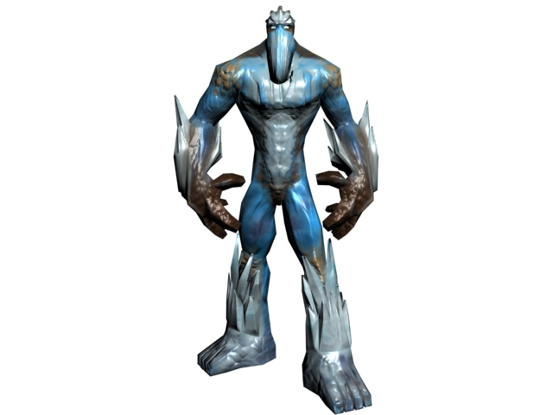
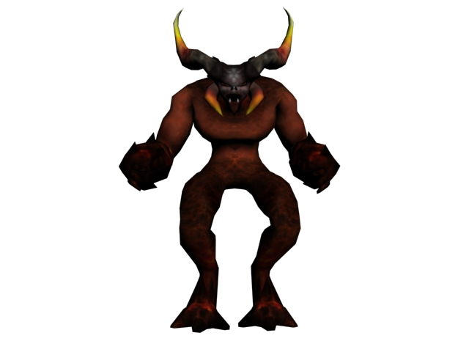
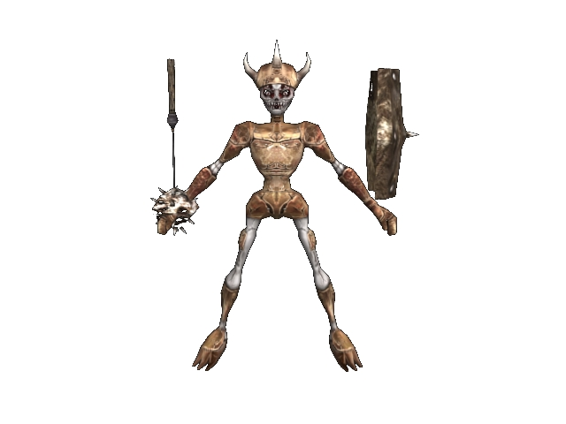
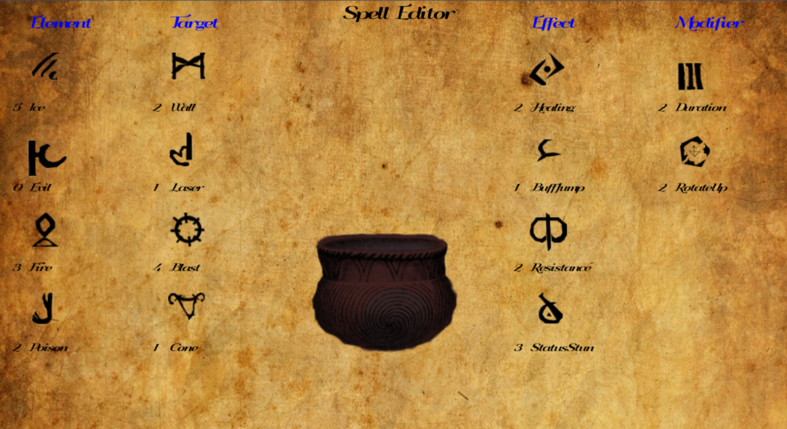
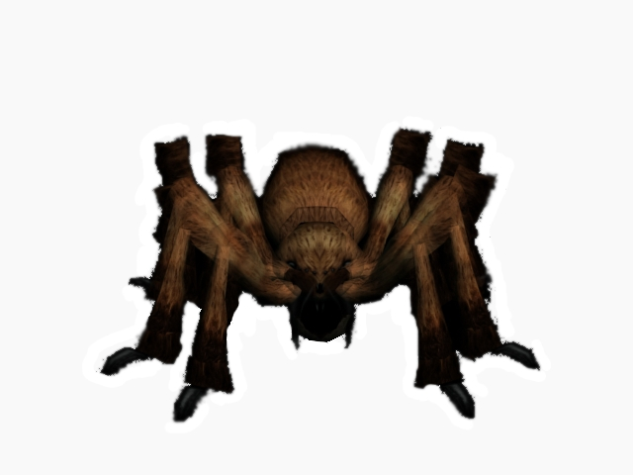
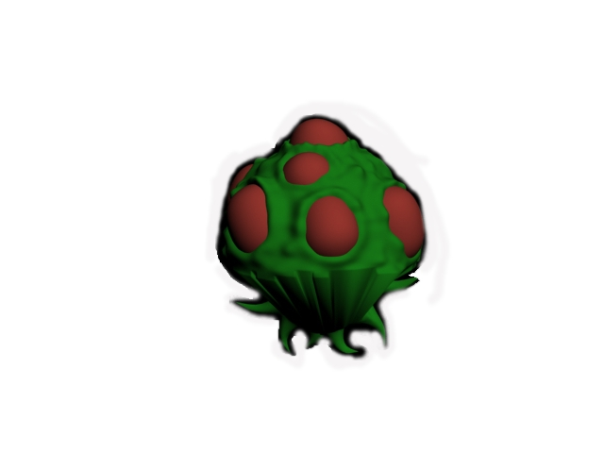
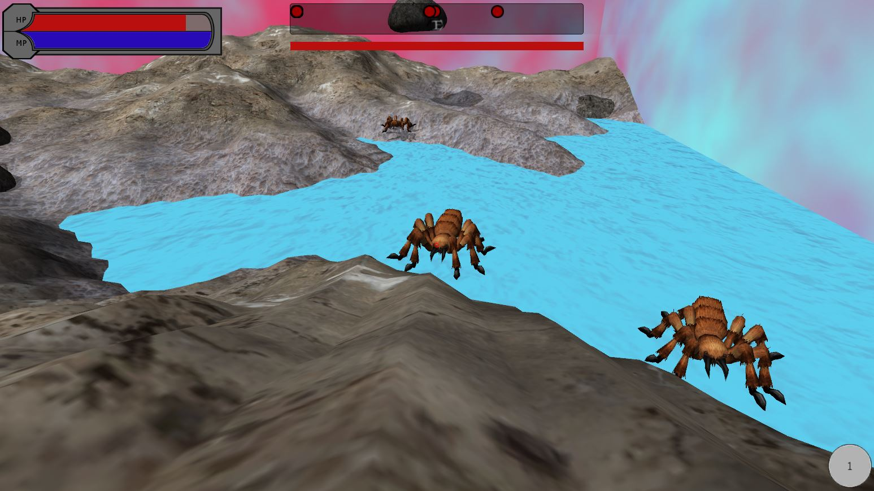
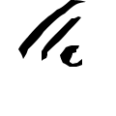
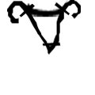
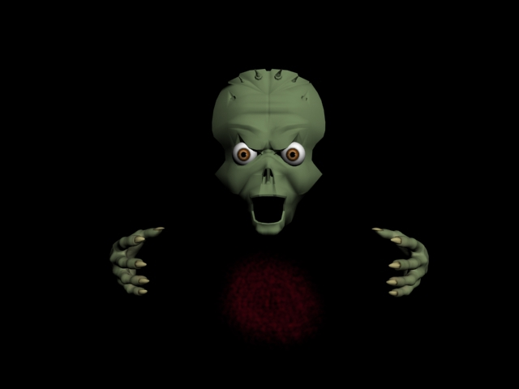
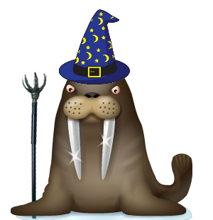
Game Objective
The objective of Spellements is to reach the end of the map and save the world by defeating the boss that waits for you there.
As you progress through the game you will defeat monsters, which have a chance to drop new runes. Picking up runes increases your stats and gives you new spell options, so you have to make sure you find enough to have a chance to defeat the boss.
However, you only have one life. If you die, the game is over and you need to start again from the beginning.
Spellements
Gameplay
Mehul Azad, Richard Georgeoff, Shawn Lee, Eric Mathews, Brian Orchosky, Alex Perry
Enemies
Ice Golem
A hardy race corrupted by magic. They are Excellent spellcasters who bombard the player with a variety of ice spells.
Introduction
Spellements is an arena based Rogue-Like that focuses on using a highly customizable magic system to defeat enemies and progress through the game. Spells are created by combining magical “Runes”. The runes that drop and the levels that you play through are all random, so every time you play through the game will be a new experience.
In addition, you can play through Spellements with a friend, working together to overcome hordes of monsters. Many kinds of spells truly excel in this mode, where players can choose different roles in the party and tailor their spell selection to help them support their friends.
Demon
The strongest troops of Lord Wycliff’s armies. Cast damaging fire spells. Watch out for it’s fire breath!
Skeleton
Ancient sages risen from the dead by Lord Wycliff’s necromancy. These enemies heal their wounded allies.
Spell Editor
Controls
Spellements is played using a mouse and keyboard.
W (or up arrow) – Moves forward
A (or left arrow) – Moves left
S (or down arrow) – Moves backward
D (or right arrow) – Moves right
Alpha 1-6 – Selects active spell
Esc – Pause game to menu
Mouse Left Click – Cast current spell
Custom spells can be created between levels using the Spell Editor.
You can have up to six spells at a time, each one bound to a hotkey.
Every additional rune makes the spell cost more mana.
More than one of the same rune can be used to increase its power.
Each spell must have at least one targeting rune and at least one element or effect rune.
Spider
A corrupted native species of the world. They are aggressive enemies that although weak individually, will swarm an inexperienced player.
Egg Sack
Pockets of magic found their way into the flora of the world. These plants will explode when the player gets to close, catching foolish players in their blast for massive damage.
Heads-up Display (HUD)
3
Elements |  | Elements can be used either directly to deal damage to an enemy or to modify other kinds of spells.
 | Fire | Cause damage with flames. Orange/Red color.
 | Ice | Cause damage with ice. Light blue color.
 | Poison | Cause damage with poison. Green color.
 | Evil | Only available to enemies. Dark Red color.
Targeting |  | Targeting runes define the behavior of the spell after it is cast
 | Range | Launch a sphere that contains the spell, which detonates when it hits an object.
 | Self | The spell affects the caster instead of or in addition to the normal target of the spell.
 | Blast | The detonation has the shape of a spherical blast
 | Cone | The detonation has the shape of a cone
 | Wall | The detonation has the shape of a vertical wall
 | Beam | The detonation has the shape of a long straight line
Effect |  | Effect runes define what happens when the spell hits something, and can be beneficial or harmful.
 | Resistance | Causes the target to resist some damage from the elements that are attached to this spell.
 | BuffMoveSpeed | Increases the movement speed of the target.
 | BuffJump | Increases the maximum jump height of the target.
 | BuffRegeneration | Increases the rate at which the target’s mana regenerates.
 | SlowMoveSpeed | Reduces the movement speed of the target.
 | Stun | Makes the target unable to move or cast spells for a very short period of time.
 | Healing | Restores some of the lost health of the target. Gold/White color.
 | Force | Applies a force to the target that knocks the enemy back
Modifier |  | Modifies the way that the spell acts after it is cast
 | Duration | Makes the spell and the effects of the spell last longer.
 | RotateUp | Rotates the shape of the spell by 90 degrees up
 | Solid | The area of the spell makes a physical wall, impeding enemies’ movement.
1
2
Lord Wycliff
The evil behind the corrupted magic. Overloaded with the powerful evil magic element, this boss casts spells from five locations which must be independently killed:
Head – Weakest section, but protected by a magic barrier
Eyes – Lasers and Nuke Spells
Left Hand – Healing and Minefields
Right Hand – Tornados and Remote Spells
There are multiple phases to the fight:
Phase One – Standard phase, attack the body parts!
Phase Two – Spider spawn
Phase Three – Ice Golem Spawn
Phase Four – Berserk
5
4
1 – Player Health and Mana Bars
2 – Target Health Bar
3 – Compass (shows enemy locations and cardinal directions)
4 – Active Spell Indicator
5 – Targeting Reticle
5
Multiplayer
The server has sole control over choosing the next level to play in the world map. The server is also the only one able to exit levels.
All spells have friendly fire, so each player must choose spells to effectively fight without hindering teammates. They can also support the other players with buff or healing spells.
Defeated players can be revived by active players if the active player stands near the defeated player for five seconds without casting spells.

